Slide 1
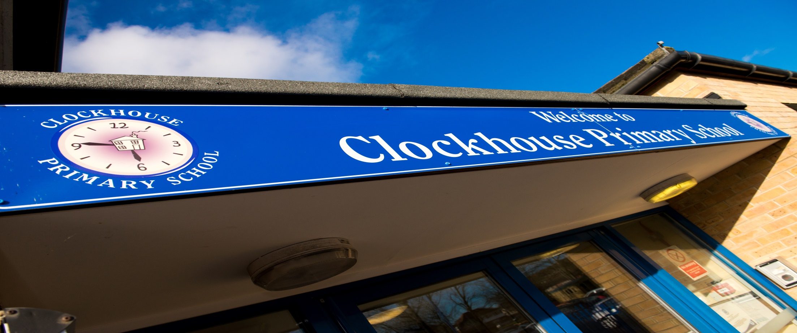
Vision and Values
Learning Behaviours
Character Education
British Values
Inspiration and Aspiration
Social, Moral, Spiritual, Cultural Development
Life Skills
Global Citizenship
The Clockhouse Experience
Curriculum Enrichment and Innovation
Religious Education
The National Curriculum
Relentless and Rigorous
Wow Curriculum
Memorable Learning
Community Development and Support
The Clockhouse Experience
Philosophy for Children
Thinking Skills
Outdoor Learning
Forest School

Slide 2
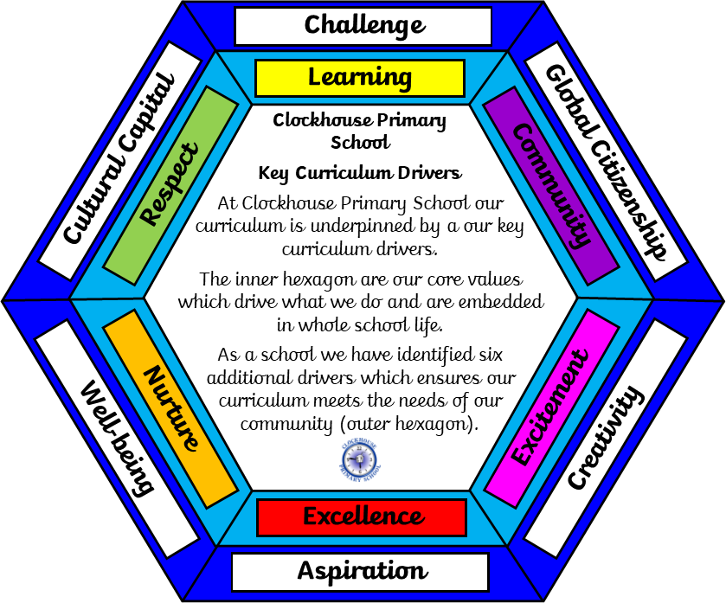
The Clockhouse Experience
The Clockhouse Experience

Slide 3
The National Curriculum
Our Curriculum Rationale
What do we want for our children and how will we work together to achieve this?
At Clockhouse Primary School we have worked collaboratively to design our unique Clockhouse Curriculum which is underpinned by our whole school Vision and Values and is personalised to the needs of our school community. Whilst it is vital that our children learn what is in the statutory National Curriculum, at Clockhouse we know that our children need much more than this.
As a school we adopt a holistic approach which fully recognises that balancing our children’s needs with the statutory curriculum can be a challenge, but instead of the two acting in opposition we aim to ensure the content of the curriculum meets the needs of children whilst also fulfilling statutory requirements. In order to do this, we have established the ‘Key Curriculum Drivers’ for our school which are supported by our six Clockhouse Values. The aim of these are to ‘drive’ the decision making for our curriculum and ‘drive’ learning and teaching. As well as this we use these 'drivers' to underpin the development work we undertake in all areas of school life and to ensure our curriculum offer is enriched and personalised to meet the needs of our community and reflects our location here in Collier Row, Romford.
The Clockhouse Experience

Slide 4
Religious Education
Our RE curriculum ensures that the children are provided with a high-quality religious education which inspires them to develop a curiosity and fascination about the world religions that will remain with them for the rest of their life. RE contributes dynamically to children’s education by provoking challenging questions about meaning and purpose in life, beliefs about God, ultimate reality, issues of right and wrong and what it means to be human. In RE they learn about and from religions and worldviews in local, national and global contexts, to discover, explore and consider different answers to these questions. Children learn to weigh up the value of wisdom from different sources, to develop and express their insights in response, and to agree or disagree respectfully.
As a school, we provide a stimulating, interactive, fun and challenging RE curriculum. Our aim is to instil a sense of tolerance to those of a different faith and to have an unbiased understanding of the religions studied. This learning will work towards eradicating the stereotypes of different religions and to address any misconceptions the children may have acquired. We want to break the cycle of religious discrimination and the ideas which stem from this. We want the children to value the ideology of religions which are different to their religion and to see that many religions have common themes. We want to bring the religious communities into our school and to give the children the opportunity to ask questions in order to address things they are unsure about.
The Clockhouse Experience

Slide 5
Spiritual Development
During their time at Clockhouse Primary School, children develop a set of values, principles and beliefs based on the core values of the school, which inform their perspective on life and their patterns of behaviour.
Moral Development
Pupils develop consideration for each other's feelings with an awareness of their personal impact on others. They are able to reflect on their actions when things do not go entirely to plan. Pupils have a set of values based on the school’s strong ethos and an age appropriate understanding of right and wrong. This results in their positive behaviour both inside and outside of the classroom, including good behaviour for learning.
Social Development
The School Parliament, elected by each class, meets with a school leader to communicate the views and aspirations of their peers. Many pupils are active each day of the week in the capacity of classroom helpers, sports leaders and play leaders. Children's achievements and activities inside and outside school are promoted and celebrated publicly. From entry children are encouraged to develop and express their views clearly and with regard to the feelings of others.
Cultural Development
The school extends pupils’ knowledge and understanding of other cultures. As part of their learning about culture, pupils explore similarities and differences between different faiths using a good range of artefacts and resources. Pupils' begin to understand their own culture through music, dance, art, drama, literature and history in the curriculum. As part of their exploration of their own and others’ religions, pupils visit different places of worship.
Social, Moral, Spiritual, Cultural Development
The Clockhouse Experience

Slide 6
Life Skills
As a school we place importance on children developing the skills they need to succeed in life along with all children achieving their potential academically.
Along with the subject based curriculum each year group has a life skill curriculum which allows them the opportunity to develop and support the learning of these valuable skills. Whether it be learning to use a knife and fork or tying shoe laces, or learning to sew on a button or making a cup of tea the children will be given the opportunity to develop these life long skills.
In Nursery, the children learn to how to sit and listen to a story, to wash their hands correctly and to hold a pencil correctly.
In Reception, the children learn to hold a pencil correctly, to dress themselves correctly and to ask and answer a question.
In Year 1, the children learn to use scissors correctly, to use a knife and fork correctly and to learn how to cross a road safely.
In Year 2, the children learn to post a letter, to cut and chop vegetable correctly and to tie shoelaces.
In Year 3, the children learn to fold clothes correctly and put them away in a PE bag, learn the importance of recycling and how to use money to pay for something.
In Year 4, the children learn how to wash and dry up, to read a bus/ train timetable and to sew a button onto clothes.
In Year 5, the children learn how to stay safe in the house, to read and follow a street map and know how to behave in the local community.
In Year 6, the children learn how to save money, to be able to tie a tie and to know basic of first aid.
The Clockhouse Experience

Slide 7
Wow Curriculum
Memorable Learning
At Clockhouse, we aim to make learning as fun and engaging as possible so that the children enjoy every lesson and remember their learning! We recognise and value the importance of maths, reading and writing but also work hard to ensure that the children get a broad and balanced curriculum.
We teach through a theme approach as much as possible, which changes each term or half term. At the beginning of the topic, we launch with a ‘Stunning Starter’. This could be going outside and building dens or dressing up! There are lots of fun activities planned throughout the topic, including a ‘Marvellous middle’ to keep the children hooked! At the end of the topic, we celebrate all of our fantastic learning with a ‘Fabulous finish’. We also want to share the learning with the parents and families so welcome the families of Clockhouse into school once during each topic to involve them in the learning and show off what the children have been learning.
In addition, we also aim to provide our children with exciting and memorable life experiences through our ‘100 things to do before leaving Clockhouse Primary School’. This includes experiences such as, visiting a zoo, raising money for charity and taking swimming lessons. This is our promise to the children of Clockhouse!
The Clockhouse Experience

Slide 8
Global Citizenship
At Clockhouse, it is our intention to ensure that our children understand global issues that affect themselves and others. This directly links to British Values which the school promotes throughout all its work. It is our aim to ensure that our children understand their global responsibility and the impact their decisions may have on themselves and others.
Our curriculum has been carefully mapped out to ensure children acquire ‘sticky knowledge’ that they are able to transfer to future learning. In order to establish these links, we have created five ‘Golden Threads’, which run throughout the curriculum. The Golden Threads that have been selected, link specifically to the ‘Key Curriculum Drivers’, including Global Citizenship.
The Clockhouse Experience

Slide 9
Character Education
British Values
At Clockhouse Primary School we place great importance on developing the children’s understanding of the world around them, including the difference between right and wrong. We support the development of their ‘Moral compass’ in order for the children to become responsible members of society. In addition, promote the fundamental British values of democracy, the rule of law, individual liberty and mutual respect and tolerance of those with different faiths and beliefs. These values are embedded in all that we do and are specifically taught and discussed, including during our ‘Best of British Week’.
The children are given the opportunity to take part in democratic votes throughout the year and are also given a voice through the School Parliament and Pupil Questionnaires.
The importance of Laws, whether they be those that the school abide by are consistently reinforced by all during every school day. Pupils are taught the value and reasons behind laws and rules and with this comes an understanding which is reinforced of the consequences of these being broken.
Within school, pupils are actively encouraged to make choices, knowing that they are in a safe and supportive environment. As a school we educate and provide boundaries for the children to make safe choices, through the provision of a safe environment and empowering education to promote Individual Liberty. Philosophy for Children provides a safe platform from which children can express their views about a range of issues, knowing that these views will be respected and listened to.
Part of our school ethos and approach revolves around kindness and respects for all. This is further reinforced by our three school rules, the ‘Three R’s – ‘Ready, Respectful, Responsible’. An ethos of mutual respect between all aspects of the school community resonates throughout and is developed at any given opportunity.
Tolerance of those of Different Faiths and Beliefs is achieved through enhancing pupils understanding of their place in a culturally diverse society and by giving them opportunities to experience such diversity. Assemblies and discussions involving prejudices and prejudice-based bullying have been followed and supported by learning in RE and PSHE.
The Clockhouse Experience

Slide 10
Curriculum Enrichment and Innovation
In addition to the ‘Wow Curriculum’, we provide opportunities to develop the children’s curiosity and creativity. During each topic, there are activities planned that require the children to step outside of the classroom and think outside the box. We invite visitors into school to enhance the children’s learning and understanding of the topic and also take the children out of school to provide rich and unique learning experiences. There are a wide range and variety of extra curricular clubs for the children to attend. These include clubs taught by specialist teachers. Throughout the year, the children have the opportunity to develop a variety of skills, including during our ‘Themed Weeks’, including-
Science Week – aims to promote all areas of science and help the children to develop their own innovative scientific ideas. The children are given the opportunity to meet people from all aspects of the science world to enrich their learning further.
Maths Week - children get the opportunity to develop their problem solving skills as well as working as part of a team to create project based learning tasks.
Enterprise Week – children work together as a class to plan and prepare a business idea to make the largest profit.
We are… Week – children are inspired and develop aspiration.
The Clockhouse Experience

Slide 11
Outdoor Learning
Forest School
At Clockhouse, we are very lucky to have lots of outdoor space so we try to take our learning outside as much as possible- not just for PE, for lots of different subjects! This could be a maths treasure hunt around the playground, learning to play a musical instrument on our band stand or going on a bug hunt in science!
Children in the Early Years Foundation Stage are lucky enough to have a fantastic outdoor learning area that aims to enhance all of the skills that they work on in the classroom. This includes a range of well planned and created role play areas, placing emphasis on language development and social interaction.
In addition to the outdoor learning, we also have two members of staff who are Forest School trained and plan and deliver a weekly Forest School session for some of the children at Clockhouse. Forest School is an educational approach that takes place in the great outdoors, visiting natural spaces to learn and develop a range of skills, including team work, building confidence and independence and improved physical fitness.
The Clockhouse Experience

Slide 12
Philosophy for Children
Thinking Skills
At Clockhouse Primary School, we provide the children with opportunities to express their ideas, opinions and curiosity in a safe environment, where mutual respect is demonstrated by all. All areas of the curriculum allow for whole class and small group discussion to develop the children’s thinking and understanding in the given curriculum area.
Philosophy for Children (P4C) is an approach we implemented at Clockhouse many years ago. This approach aims to develop the children’s reasoning skills and enhances their thinking and communication skills. It has been effective in improving the children’s critical and creative thinking alongside their communication and cooperation. In addition, it has enabled the children to become more reflective and to think about what they want to say before sharing their thoughts. It allows the children to challenge the thoughts and opinions of others in a respectful and appropriate manner. It is sometimes taught as a discreet session, however, it is now embedded into our curriculum and is part of the learning and teaching approach.
The Clockhouse Experience

Slide 13
Our School- A Family and a home for everyone
Our Vision
We are not just a school, we are home!
We lay the foundations for each individual’s future and for dreams to be fulfilled- whatever they may
No two bricks are the same but are accepted for their uniqueness and are placed in their own special way to meet their needs.
The cement bonds us together as a family to keep us strong, stable and safe.
We are all safe and happy under one roof, we are protected from the elements and prepared to weather every storm.
The key to success unlocks the door to future achievements unseen before.
The windows show us the reflections of our future self as ready, respectful and responsible adults.
Collaboratively, together our home is decorated with challenge and the rooms are furnished with fun.
All around, a variety of trees grow naturally from the seed of success, with nurture and care anything is possible
So we are not just a school, we are a home that provides a champion for all as well as timeless experiences and skills for a brighter future
And that is why we are called Clockhouse
Ring the bell, we’re always here!
Our vision is underpinned by our six values:
Vision and Values
Learning Behaviours
The Clockhouse Experience
Learning Excellence Nurture | Community Respect Excitement

Slide 14
Inspiration and Aspiration
As outlined in our school vision, we want our children to believe that anything is possible and therefore work hard to ensure our curriculum inspires our children to do great things!
The ‘Golden Threads’ that run throughout our thematic approach to learning focus on 5 key questions, including:
What is beyond Collier Row? Developing the children’s knowledge of the wider world .
Who changed the world? Teaching children about people who have had an impact on the world to aspire our children to see the endless possibilities that are ahead for them!
Why does the world look the way it does?’ This thread is designed to provide children with the knowledge of the world which is different to their own.
We also aim to inspire the children through our carefully planned themed weeks, such as ‘We are Week’, ‘Rock around the World Week’ and ‘Arts Week’.
‘We are Week’ focuses particularly on the possibilities that await our children to create aspirations. Throughout the week, we invite members of the community into school to talk about their jobs and achievements. We also encourage those that have left Clockhouse to come back and talk to the children about what they have achieved since leaving to inspire them to dream and give them the confidence to reach for their dreams!
The Clockhouse Experience

Slide 15
Community Development and Support
At Clockhouse Primary School, one of our values is ‘Community’. This is something that we feel passionate about and strive to support our local community and the people within it. In doing so, we aim to instil this in the children.
The parent and carer community are regularly invited into school to take part in learning and other exciting activities, including ‘Learn with your child’ mornings and sponsored walks.
‘Our Clockhouse Association’ (OCA) aims to provide exciting opportunities for the children of our school, their families and our local community.
We reach out to our local community throughout the year, including taking an active role in looking after the environment and visiting the residents of the local nursing home.
The Clockhouse Experience

Slide 16
Relentless and Rigorous
At Clockhouse Primary School, we pride ourselves on challenging each and every member of our Clockhouse family- this includes the adults too! By providing a safe and caring environment, we encourage the children to step outside their comfort zone in order to reach their full potential.
Each year, we have a motto. We have had ‘Going Above and Beyond’, ‘Making the Impossible Possible’ and ‘Dream It, Believe It, Achieve It’ but this year we are focusing on being RELENTLESS AND RIGOROUS! Each week, someone from every year group is nominated to have ‘Hot Chocolate with the Head’ for going Beyond the Possible and really pushing themselves to do something that they did not think they were capable of!
The Clockhouse Experience

